Slide 1


Statistic
Lecture 1
Dr. Nada Abdullah Rasheed
Assist prof. / Computer Science

Slide 2
Syllabus Content
Subject | Lec. No.
Introduction to Statistic | 3
Two Types of Statistics | 4
Variables | 5
Hypotheses and Predictions | 6
Populations and Samples | 7
Sampling | 8
Random Selection | 9

Slide 3
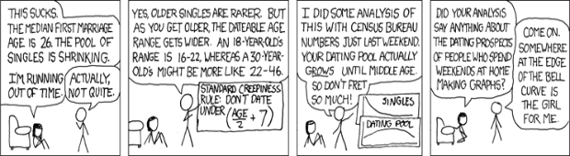
Fundamental Statistic
1.1 Introduction to Statistic:
Statistic are procedures that combine, organize, and summarize data to make inferences. Scientist collect data to generate and test theories and hypotheses, but the data are initially unorganized and ‘raw’, and statistics allow one to organize the raw data into something condensed and more meaningful. Statistical methods also allow one to examine and quantify relationships among variables to uncover trends, and to determine whether a theory or hypothesis is supported by that data.

Slide 4
Fundamental Statistic
1.2 Two Types of Statistics:
There are actually two types of statistics: descriptive statistics and inferential statistics. Descriptive statistics are used to consolidate data it into single, representative values that can be used to describe the entire set of data.

Slide 5
Fundamental Statistic
1.3 Variables
Variables are anything that can change or take on different forms. For example, blood pressure is a variable, because it can vary across people and vary across time for a single person. Sex (or gender) is a variable, because it differs across people.
In statistics, dependent variables are anything that is being measured. Dependent variables are within the operational definition for a hypothetical construct, so if we define ‘memory’ as the number of words recalled from a list of 100 words studied 24 hours earlier, the number of words recalled is the dependent variable of memory.

Slide 6
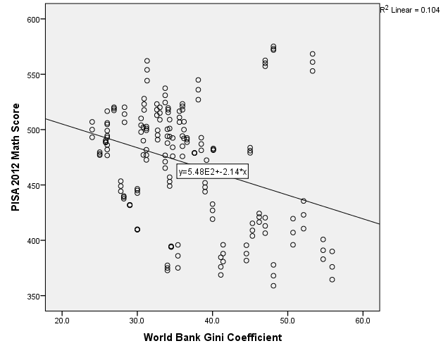
Fundamental Statistic
1.4 Hypotheses and Predictions:
Statistics are used, mainly, to evaluate research questions. When a researcher has a question, s/he designs a study, collects data, and applies appropriate statistical procedures to determine whether the data support his/her question. Everything centers on the research question, or hypothesis, which generates testable predictions.

Slide 7
Fundamental Statistic
1.5 Populations and Samples:
A population includes all members of that target group and the number of people in that population is usually labeled with an upper case N. In the first example above, the population is all people who have suffered from seasonal affective disorder and in the second example the population is all statistics students.

Slide 8
Fundamental Statistic
1.6 Sampling
The main issue with samples is whether they are representative of a population, whether the subjects in the sample accurately reflect the subjects of the population. The best way to ensure a representative sample is through random sampling, which involves selecting people from a population at random and without bias.

Slide 9
Fundamental Statistic
1.7 Random Selection
We design a study that will examine the differences in attention between video game players and non-players. The study involves a survey to assess the amount and types of video games people play and a computerized task to assess attention. We determine we need n = 50 subjects for this study and luckily we am teaching two sections of statistics, each with 25 students.

Slide 10
Fundamental Statistic
The solution is random sampling, which is simply selecting individuals for a sample in a random, unbiased manner. Think of random sampling as putting everyone’s name from a population into a hat and randomly drawing a certain number of names from the hat to create the sample.

Slide 11
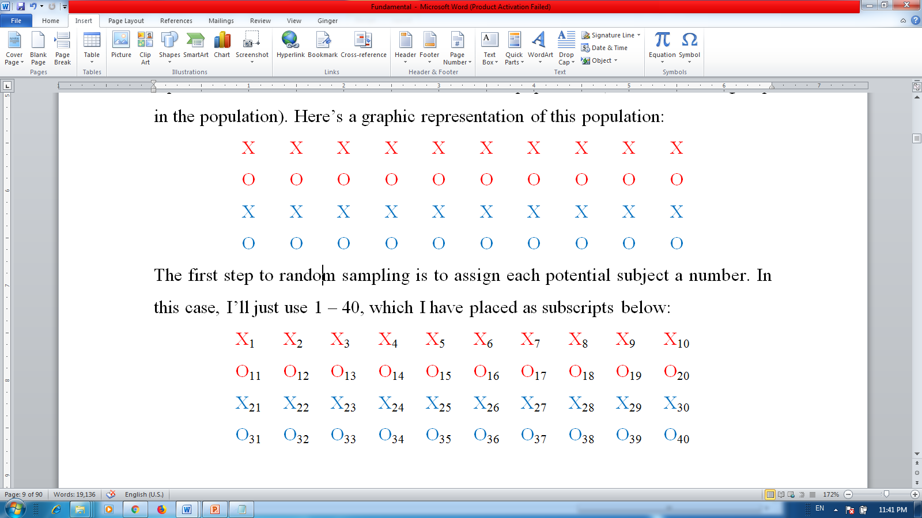
Fundamental Statistic
For example, say we have the following population of red and blue letters X and O and we need to create a sample of n = 10 from this population. Assume there are equal numbers of red and blue Xs and Os in the population (N = 10 for each group in the population). Here’s a graphic representation of this population:

Slide 12
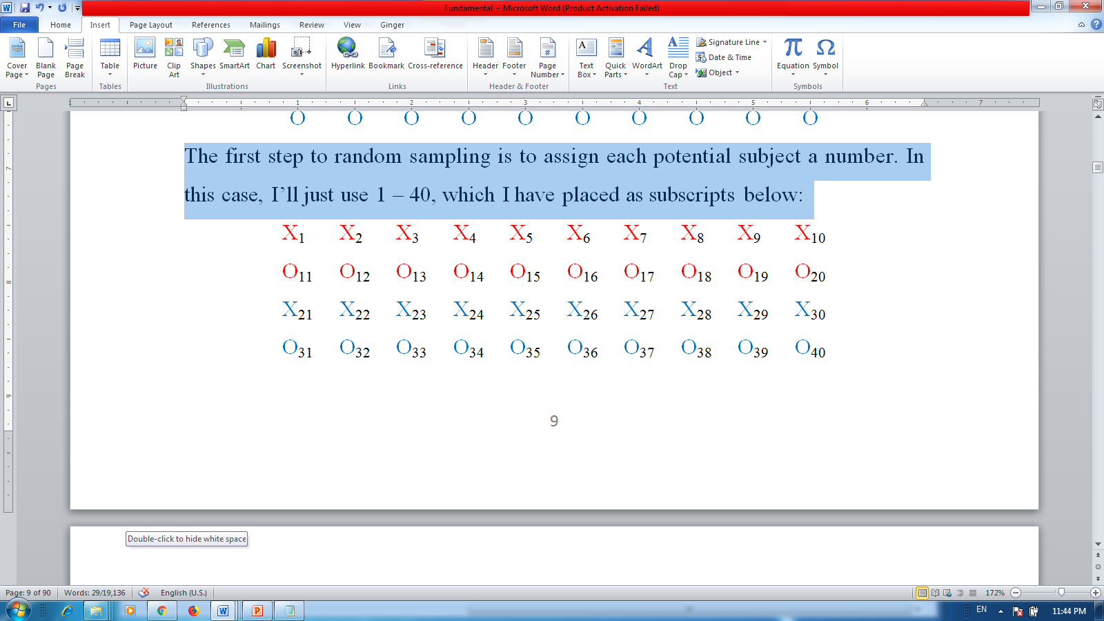
Fundamental Statistic
The first step to random sampling is to assign each potential subject a number. In this case, I’ll just use 1 – 40, which I have placed as subscripts below:

Slide 13
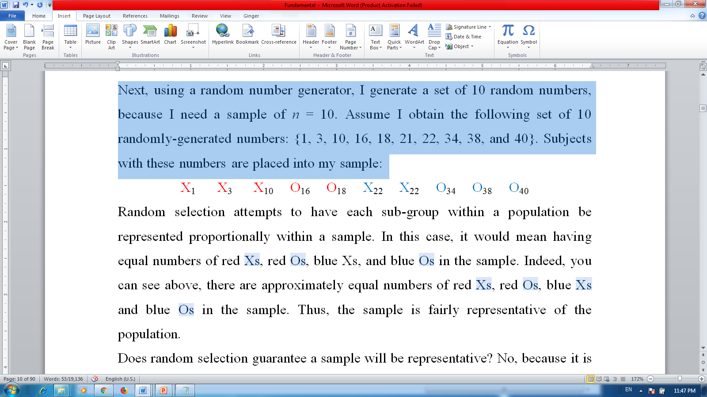
Fundamental Statistic
Next, using a random number generator, I generate a set of 10 random numbers, because I need a sample of n = 10. Assume I obtain the following set of 10 randomly-generated numbers: {1, 3, 10, 16, 18, 21, 22, 34, 38, and 40}. Subjects with these numbers are placed into my sample:

